Slide 1
What is Data Science?

Slide 2
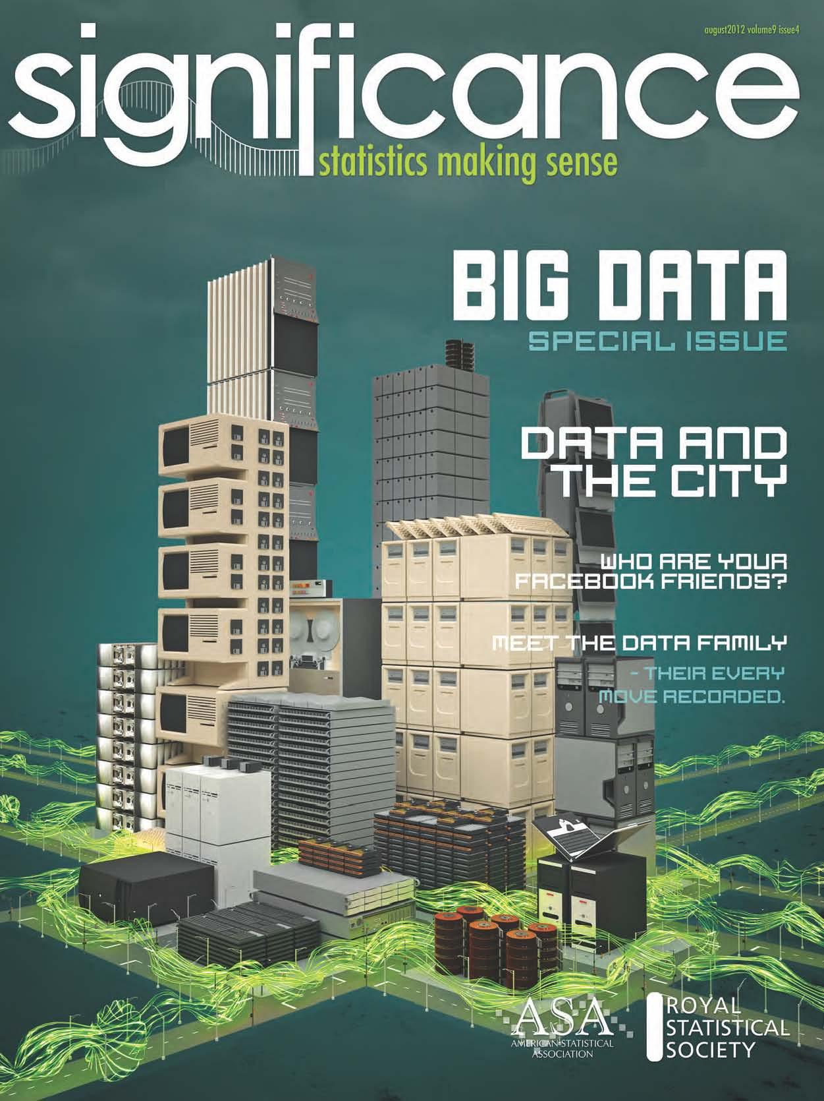
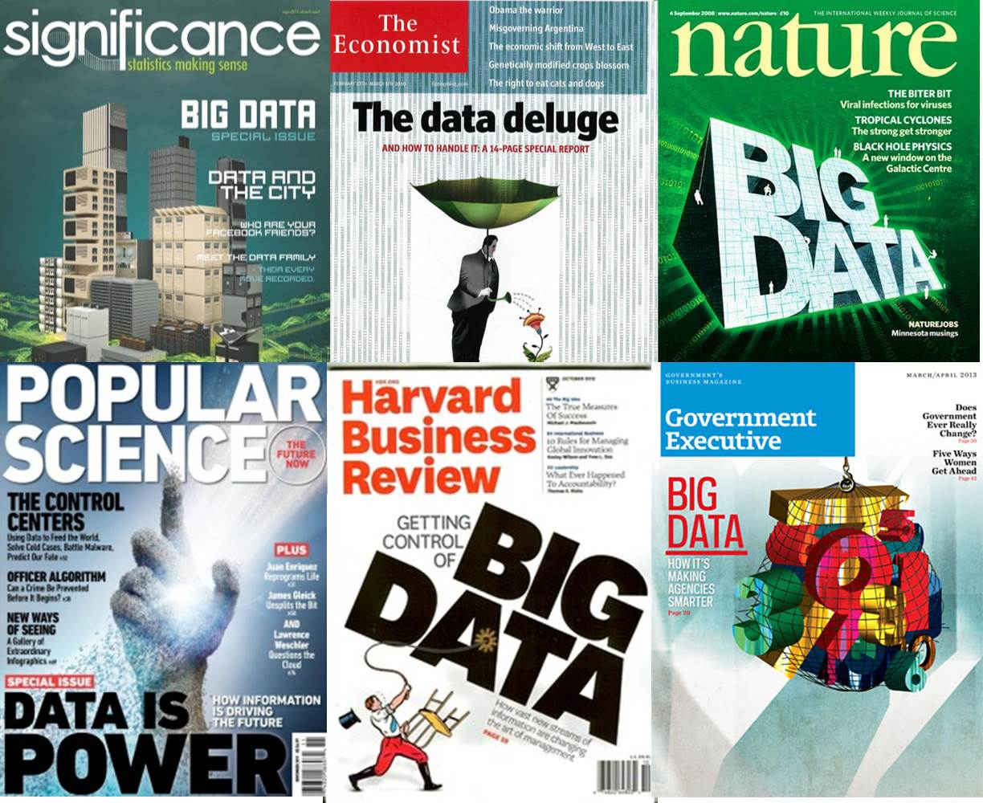
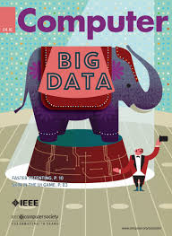
Why do they call it Big Data when they mean Data Science?

Slide 3
Data Science >> Big Data
Data Science
Data Science
Data Science
Data Science
Data Science
Data Science

Slide 4
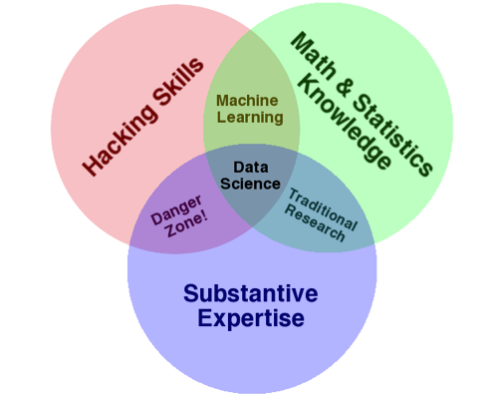
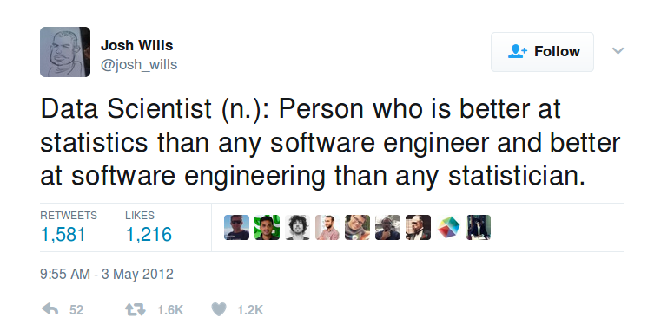
Then, what is Data Science?

Slide 5
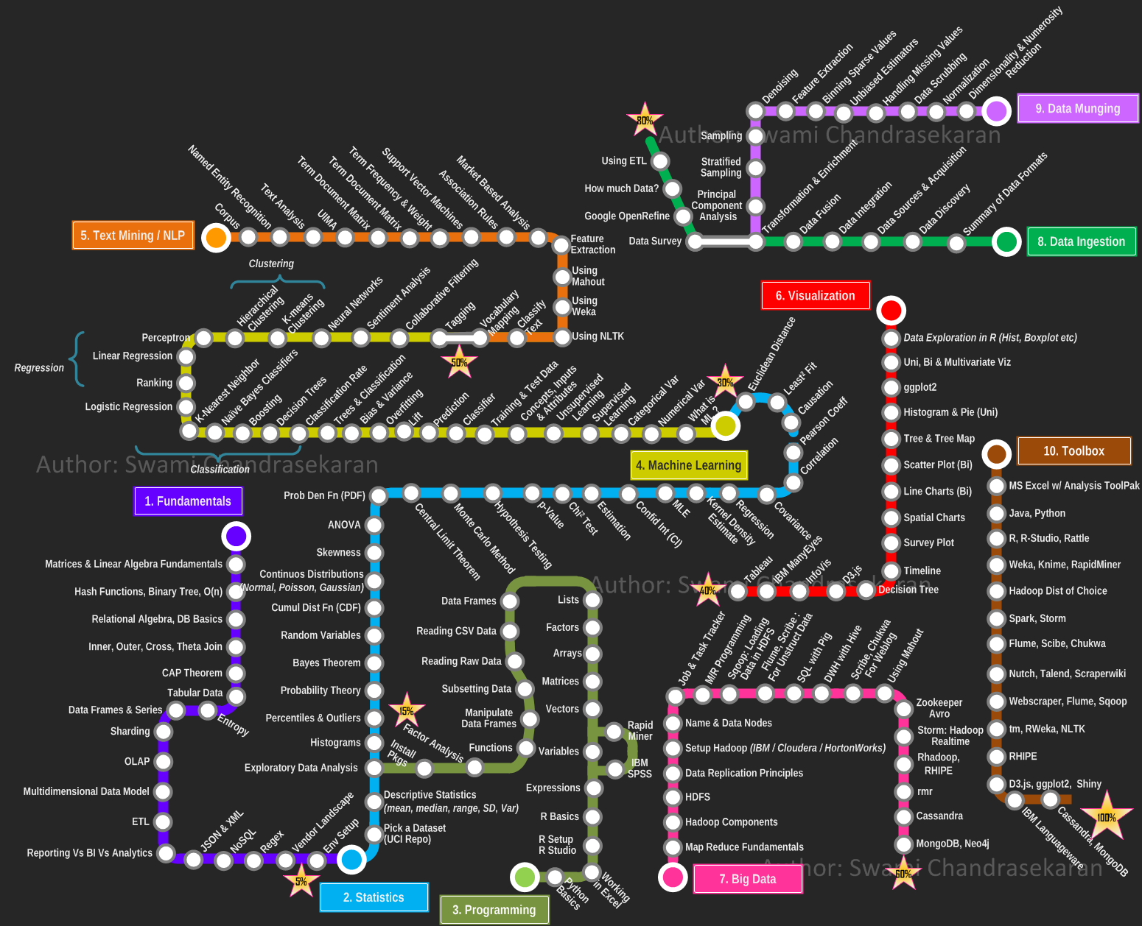

Slide 6
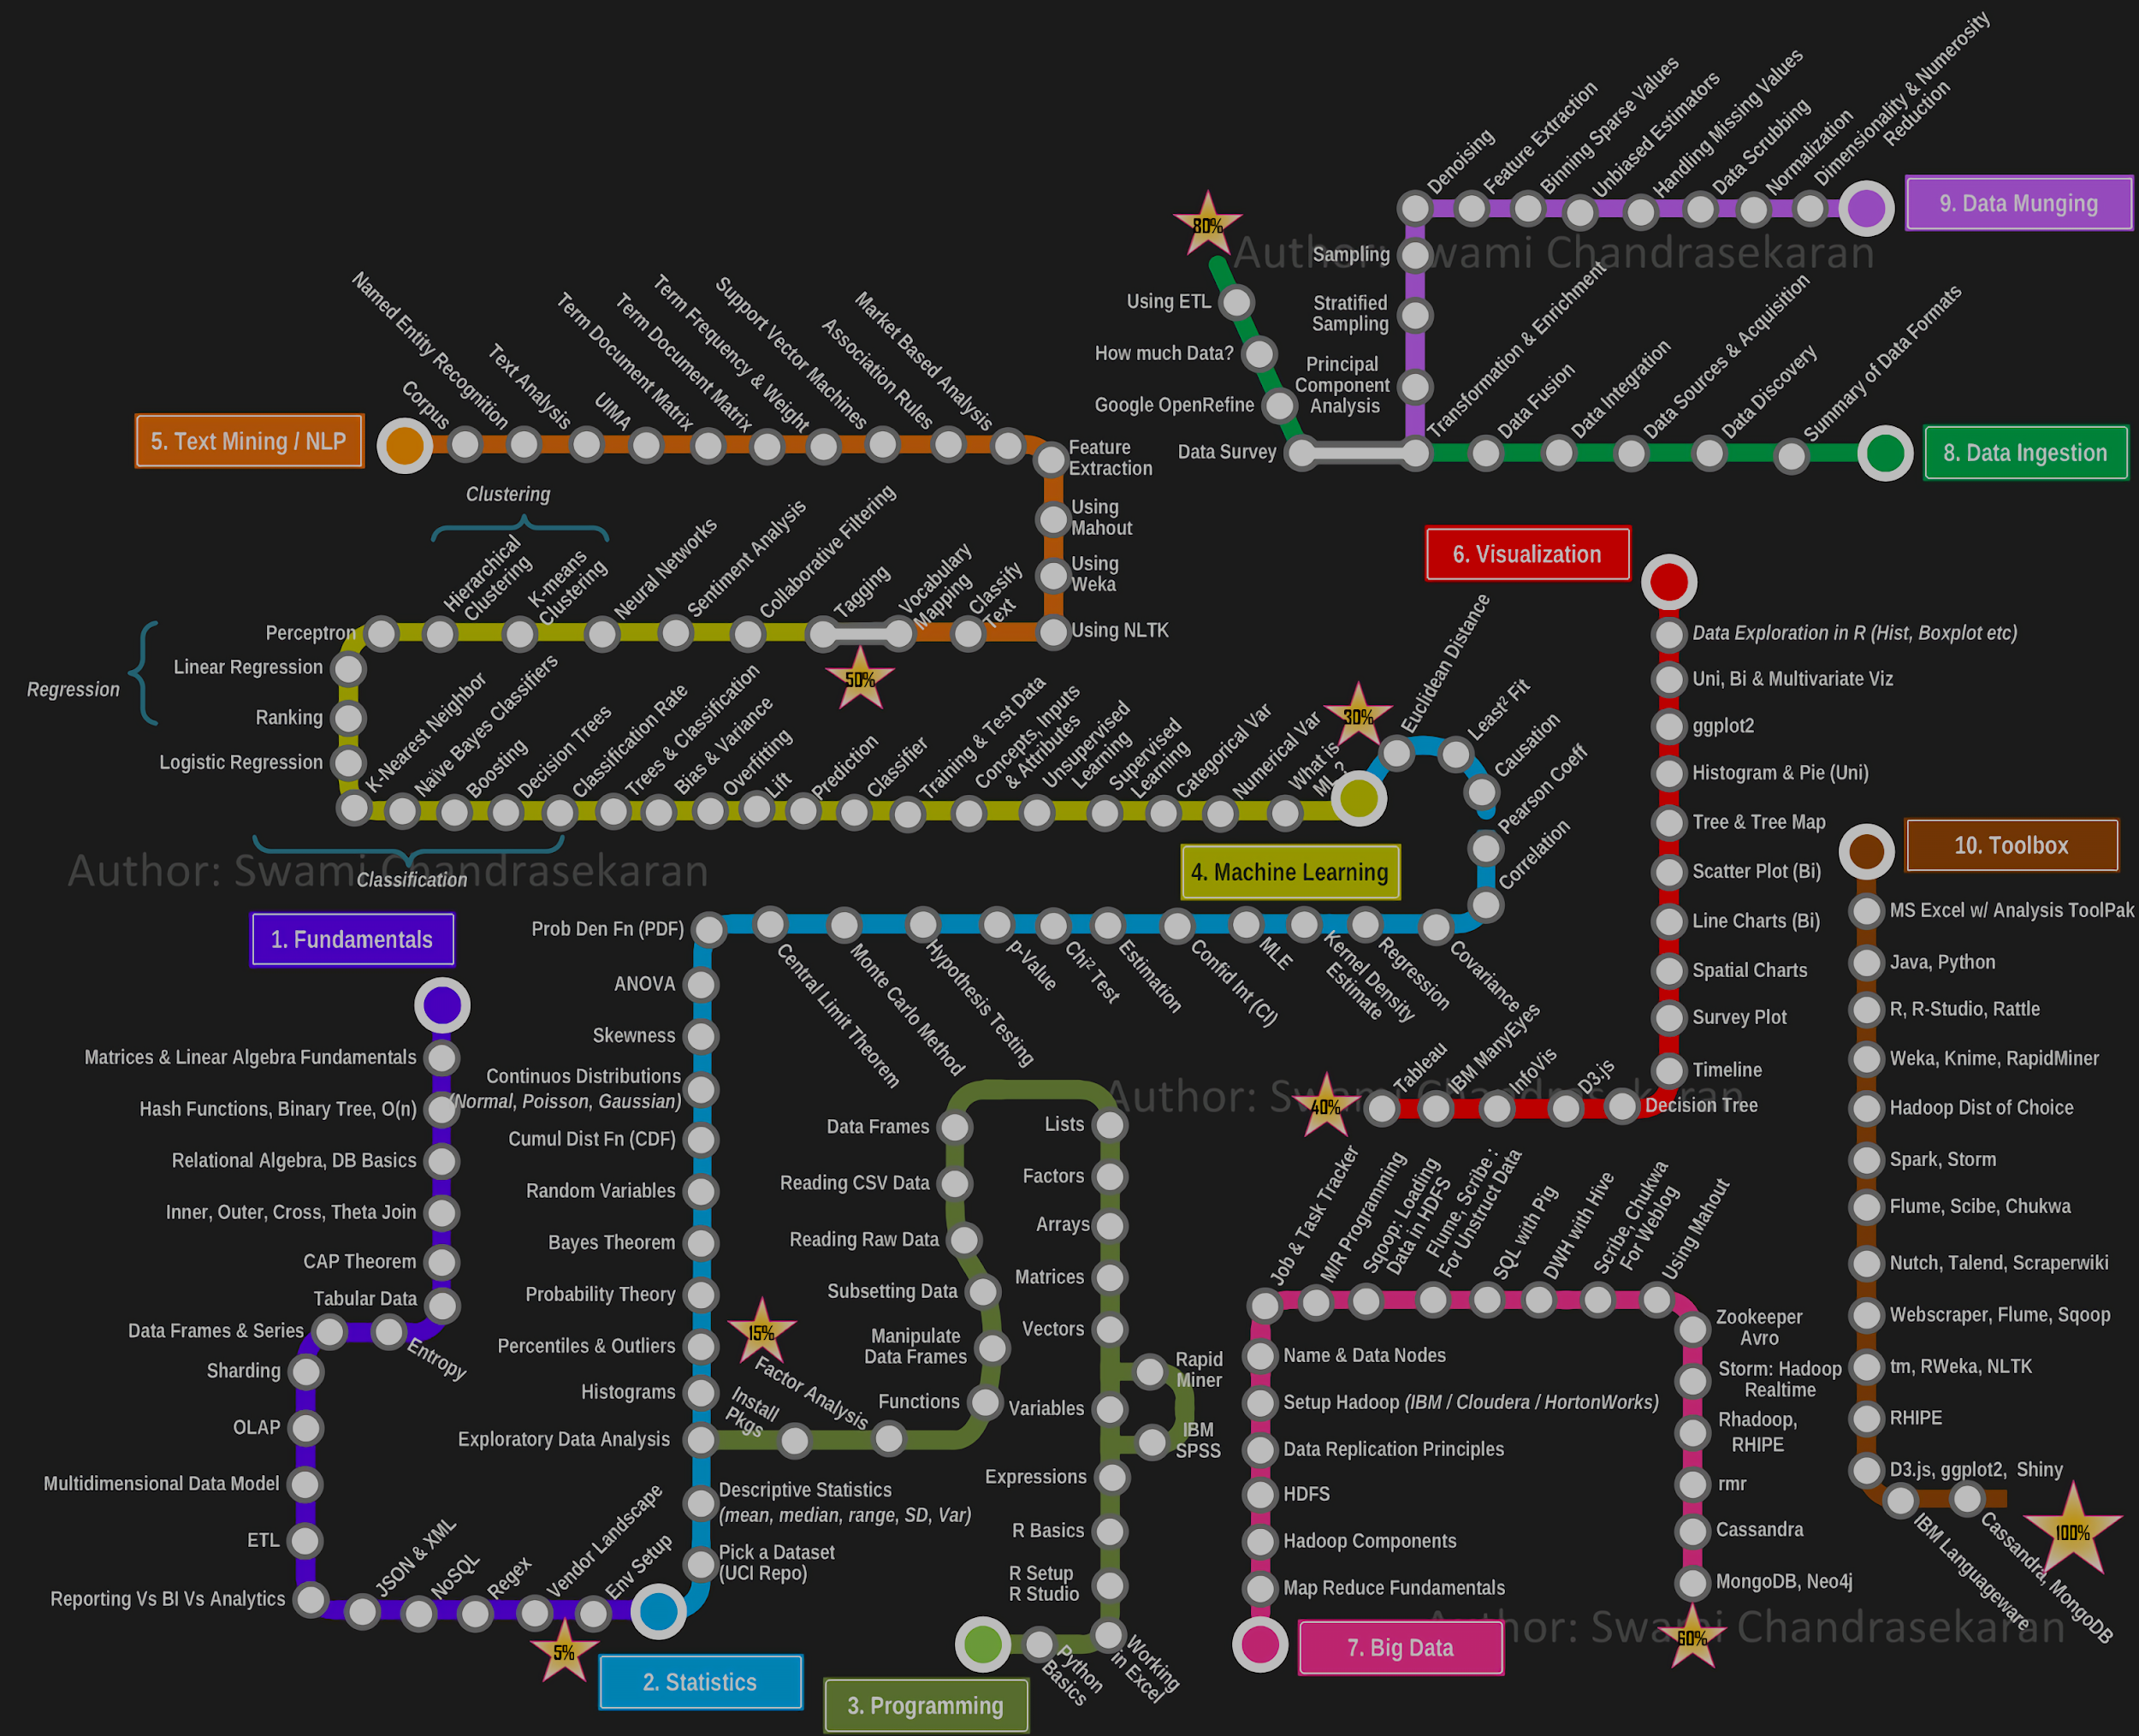
NO BIG DATA REQUIRED!!

Slide 7
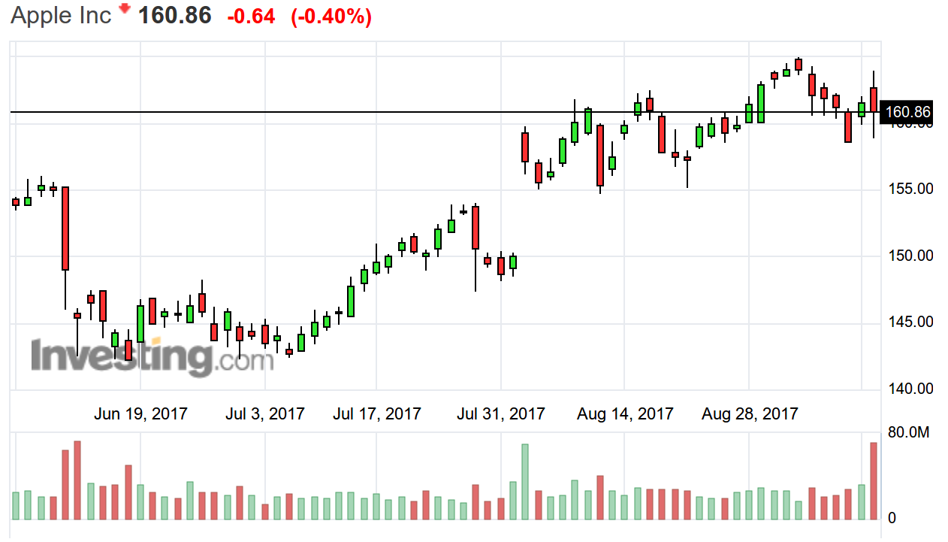

Uses of Data Science

Slide 8
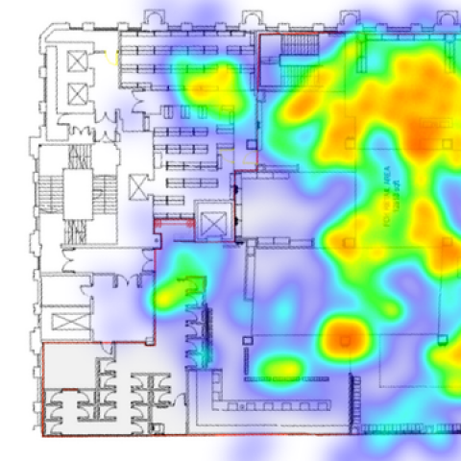
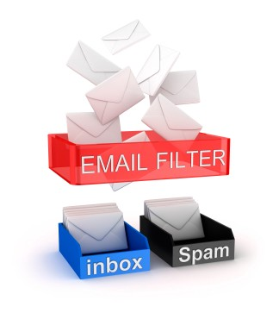
Uses of Data Science

Slide 9
The Data Science Process

Slide 10
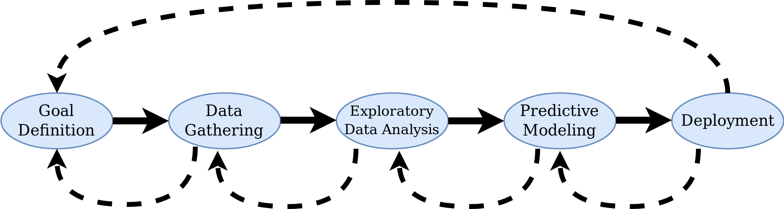
The Data Science Process

Slide 11
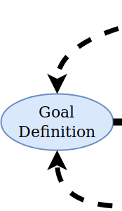
A good goal is a S.M.A.R.T. goal
Specific
Measurable
Achievable
Relevant
Time-bound

Slide 12
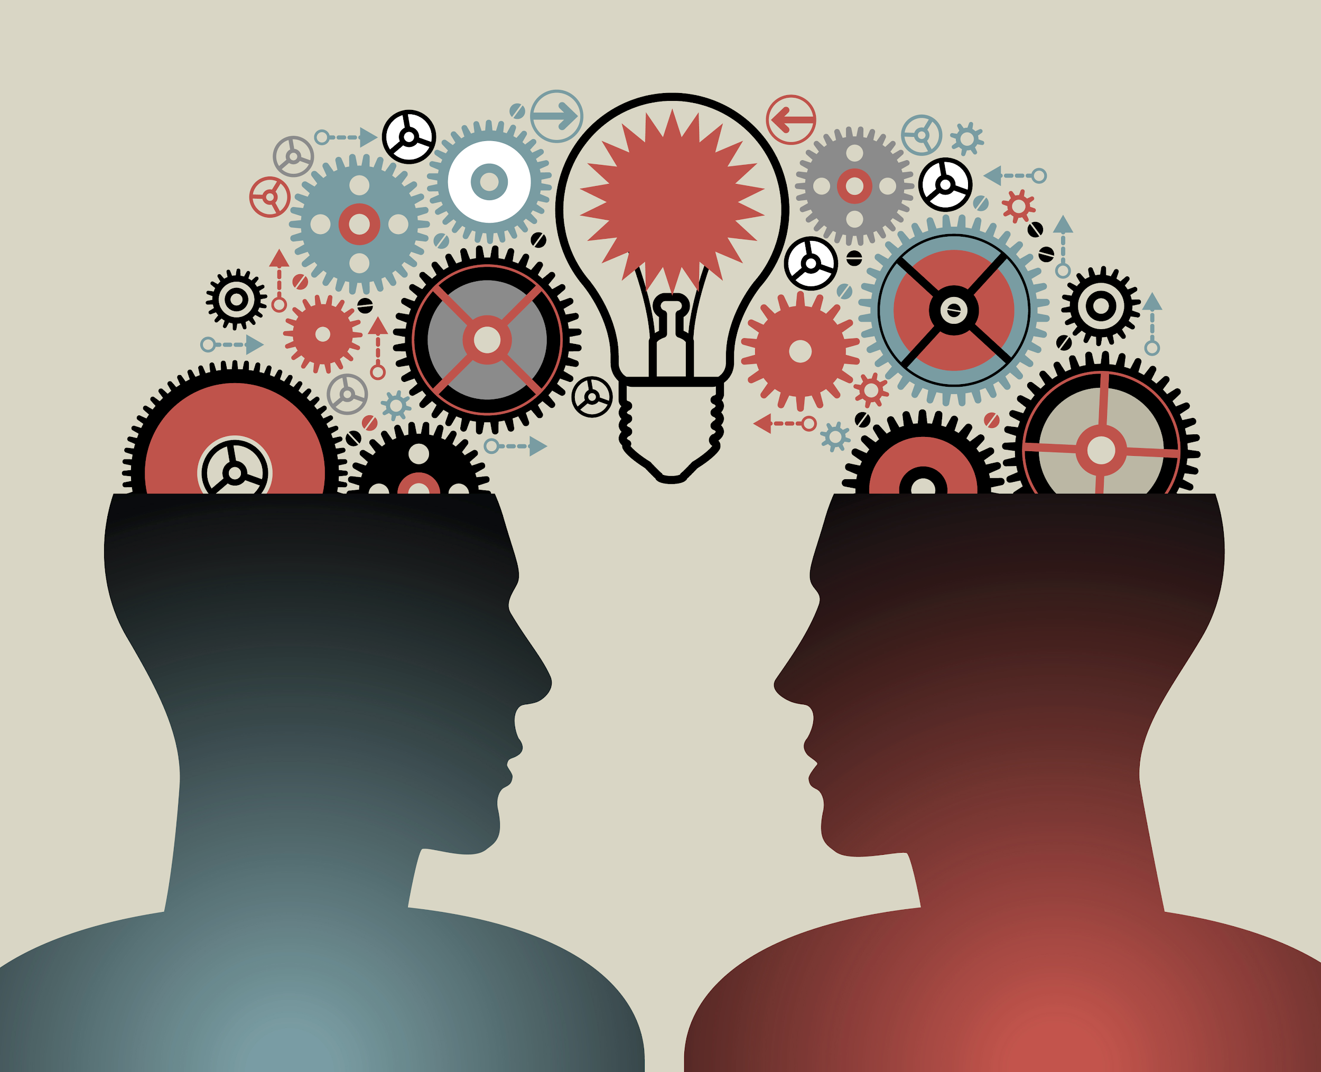

Slide 13
How to find data
Internal Data
Databases
Text files (or excel, csv, ...)
Others (pdfs, images , anything!)
Open Data Repository
UNdata
Open Data Inception
Data Brokers
Experian
Acxiom
APIs
Yahoo finance
OpenWeather
Web Scraping
Scrapy
import.io

Slide 14
Note: Data Science Resources
Newsletters:
DataMachina
ImportPython
DataScience Weekly
Python Weekly
Boards
reddit.com/r/datascience
reddit.com/r/machinelearning
DataTau

Slide 15
Note: Recommended readings
Al Sweigart (2015),​ “Automate the Boring Stuff with Python: Practical Programming for Total Beginners”
Wes Mckinney (2017),​ “Python for Data Analysis”
Allen B. Downey (2014),​ “Think Stats”
Foster Provost & Tom Fawcett (2013),​ “Data Science for Business”
Jake VanderPlas (2016),​ “Python Data Science Handbook”
Andreas C. Müller​ (2016),​ “ Introduction to Machine Learning with Python”

Slide 16
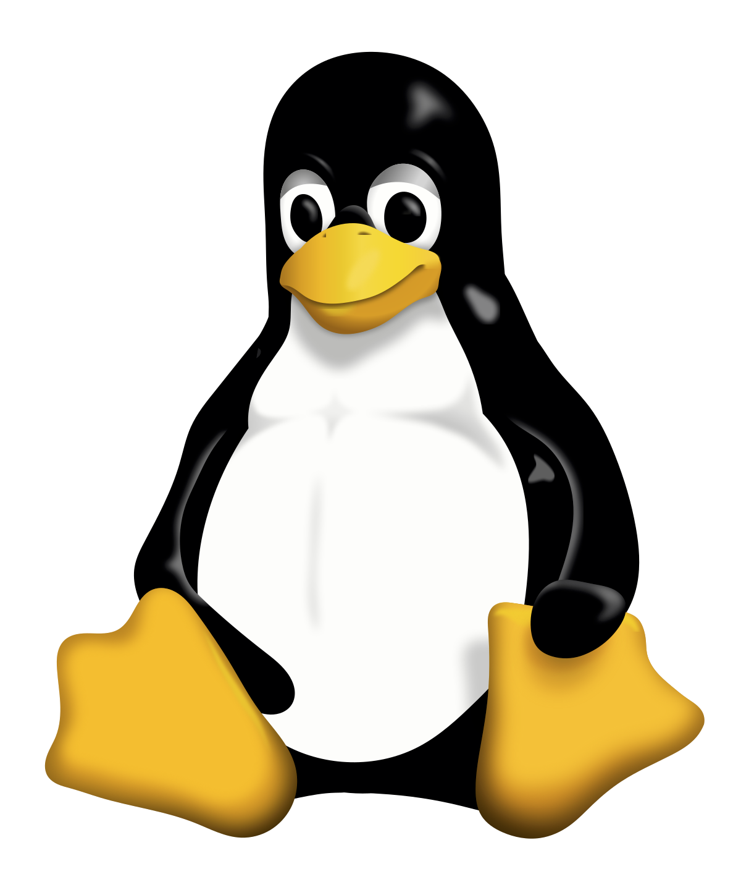


Note: OS
>
>>

Slide 17
The Pydata Stack

Slide 18
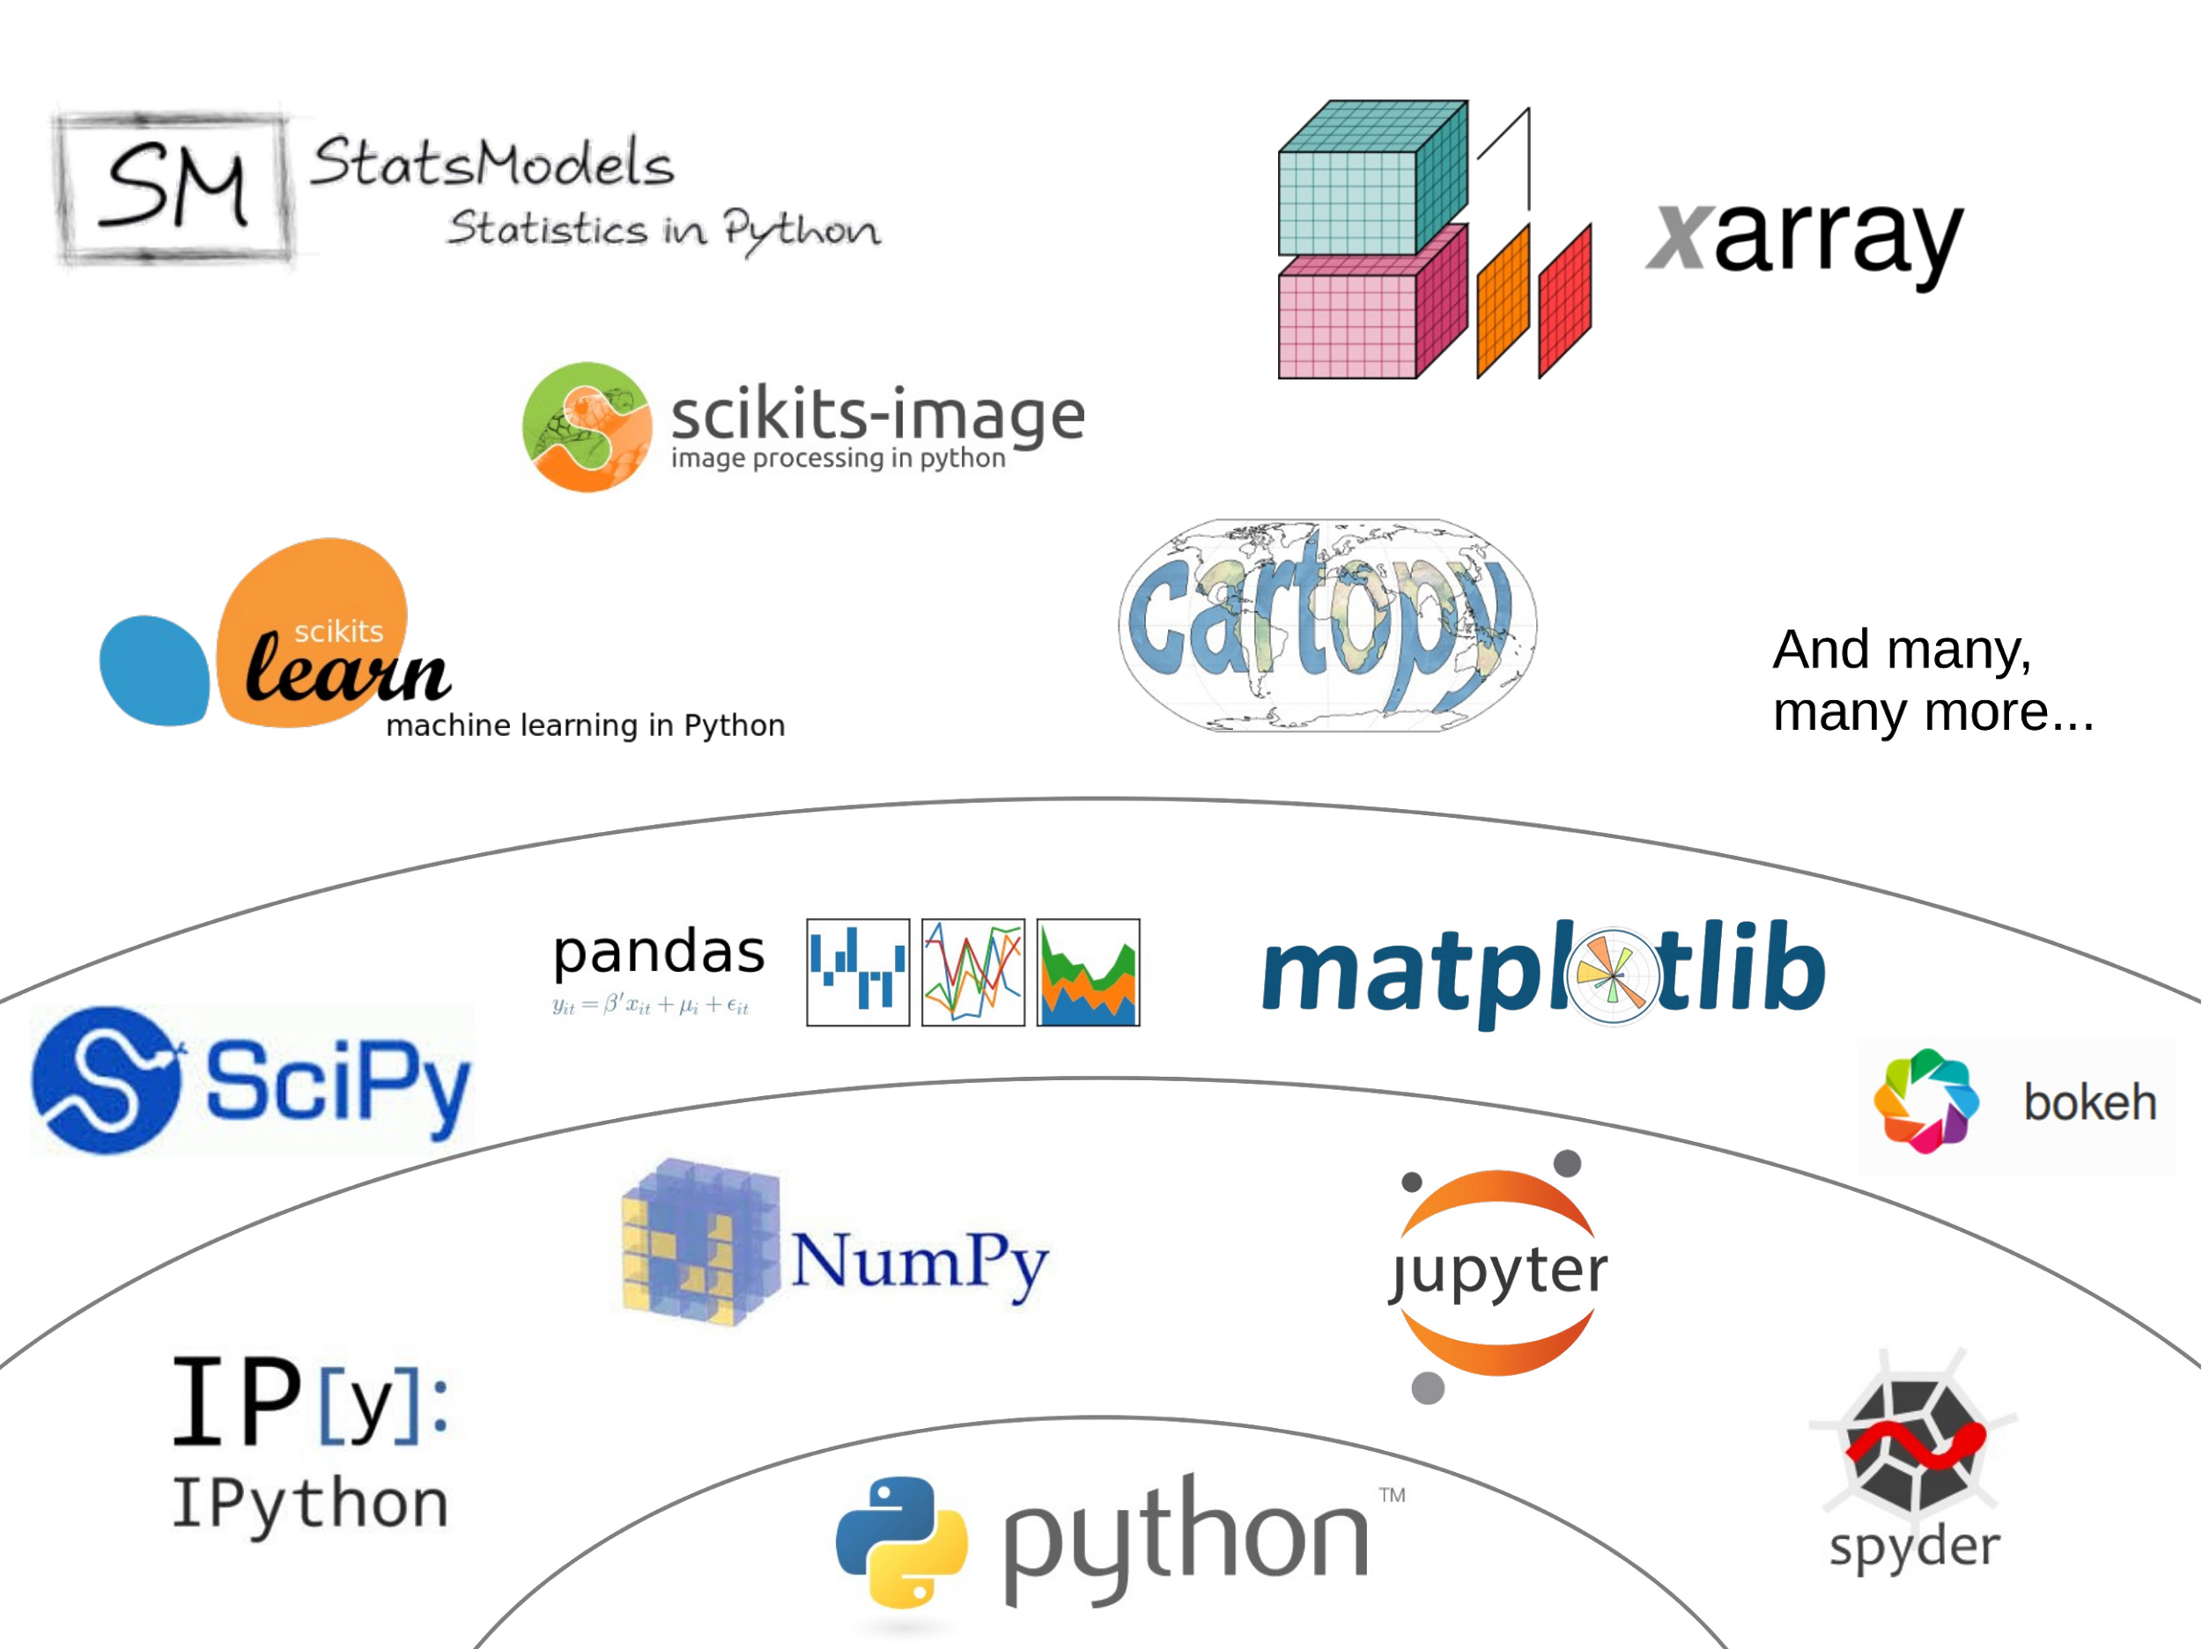

Slide 19
High performance data structure
Interactive Analysis environment
Tabular data (dataframes) in Python
Scientific computation packages
Advanced statistical packages
Machine Learning in Python

Slide 20
Note: How to visualize notebooks?
Github (example)
nbviewer.js
Binder
Google Colab

Slide 21
Show time!

